Slide 1
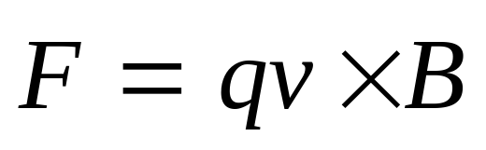
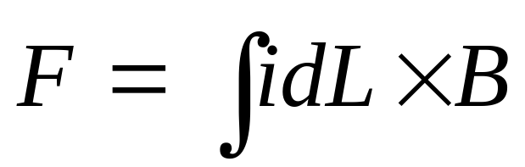
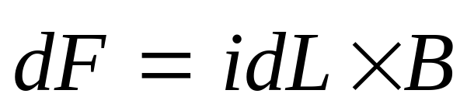
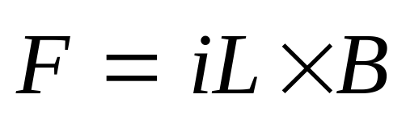
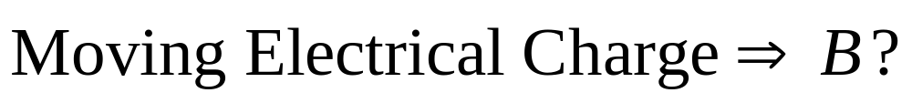
Moving Electrical Charge
Magnetic Field
Moving Electrical Charge

Slide 2
Chapter 33 The Magnetic Field of a Current

Slide 3
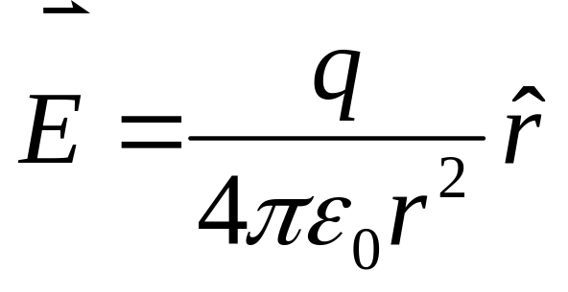



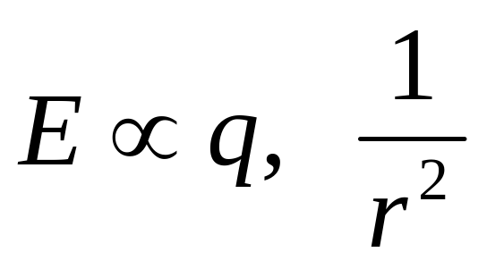
The Electric Field Due to a Charge

Slide 4
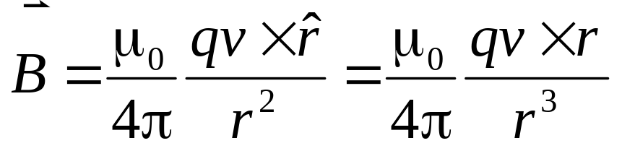
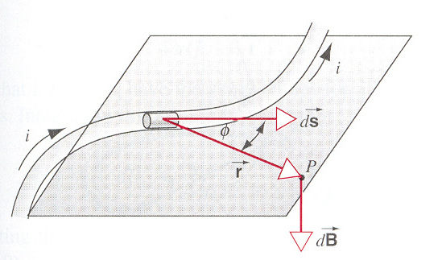
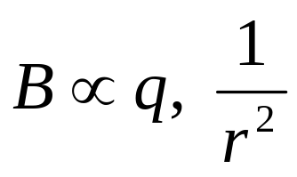
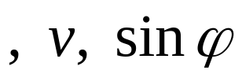
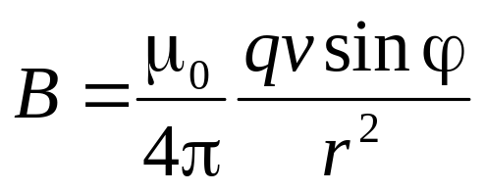
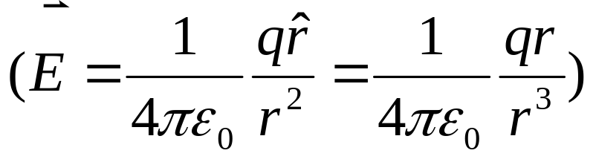


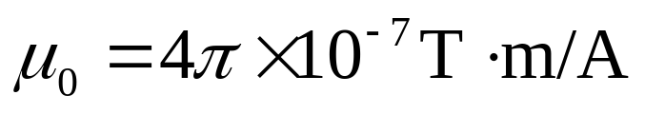
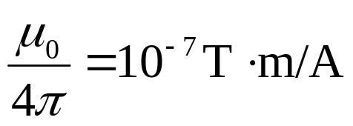
The Magnetic Field of a Current
The Magnetic Field Due to a Motion Charge
μ₀ is the permeability constant.

Slide 5
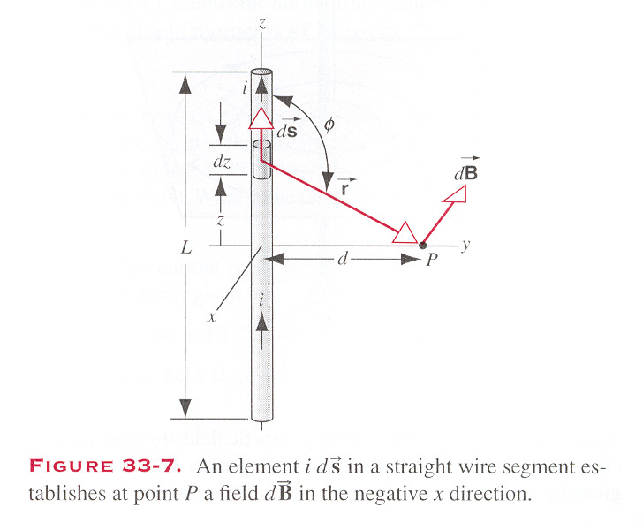
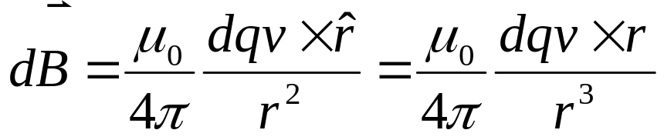
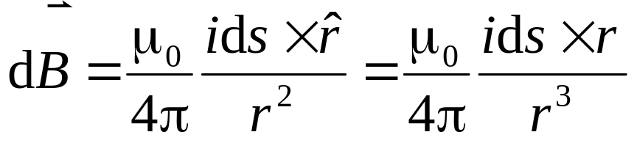
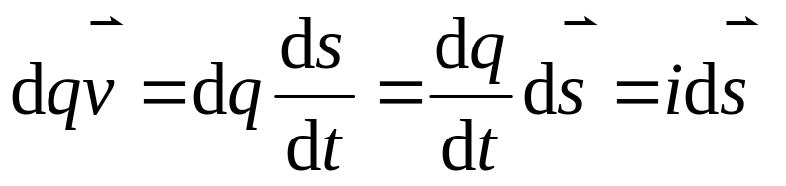

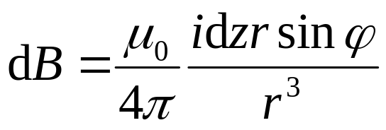
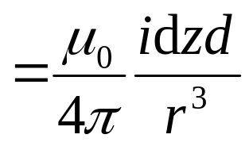
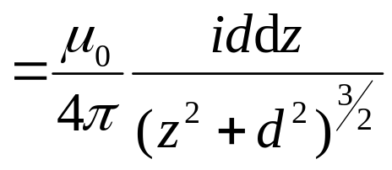
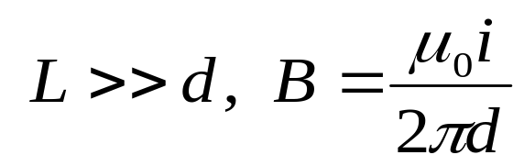
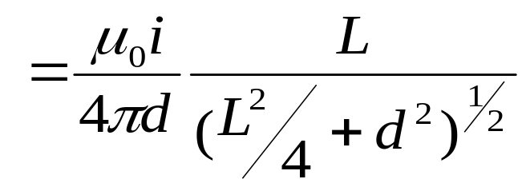
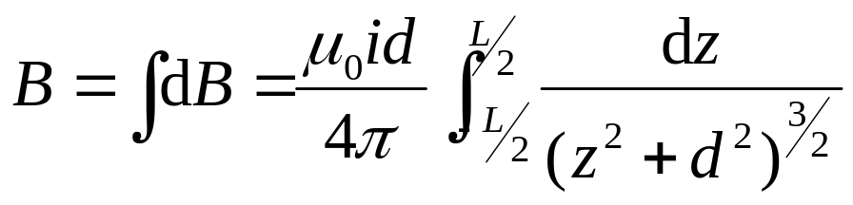
The Magnetic Field of a Current
The Magnetic Field Due to a Motion Charge
A straight wire segment
Biot-Savart law

Slide 6
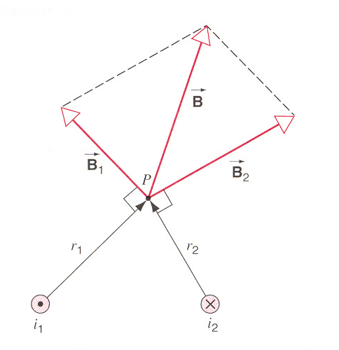
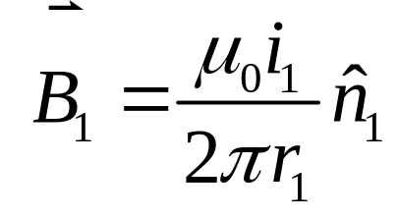
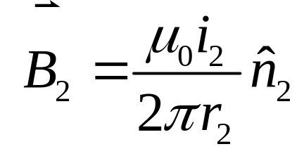
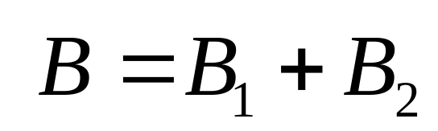
Two Parallel Current
Superposition principle
Vector sum

Slide 7
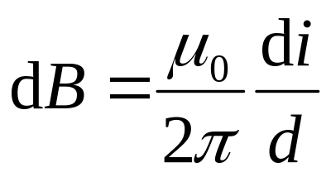
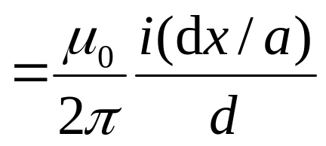
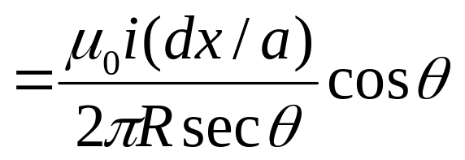
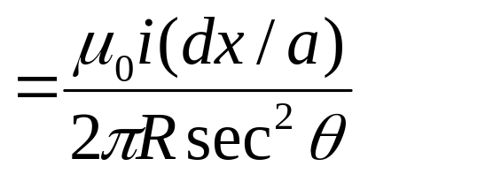
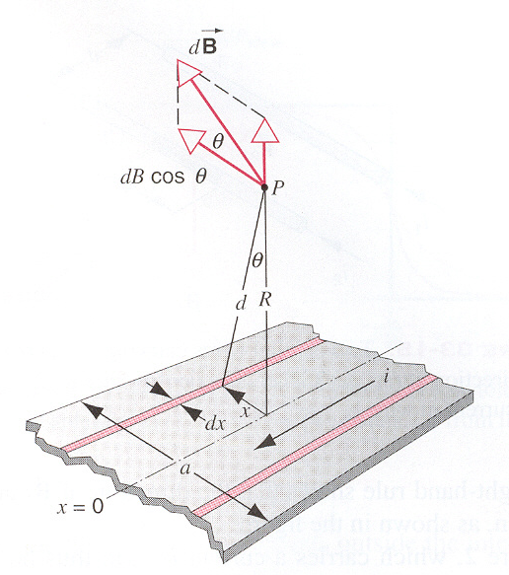
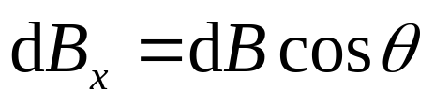
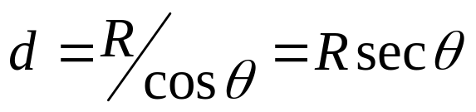
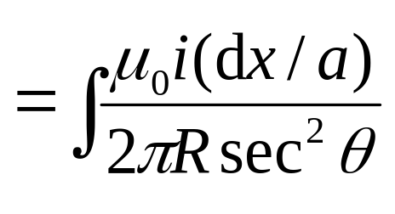
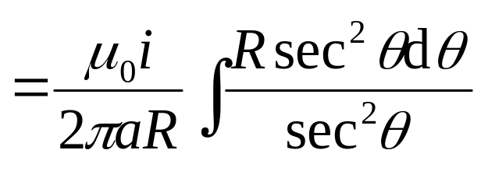
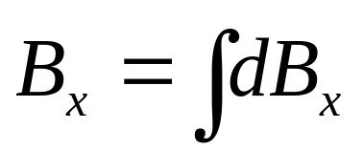


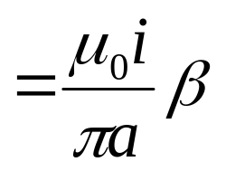
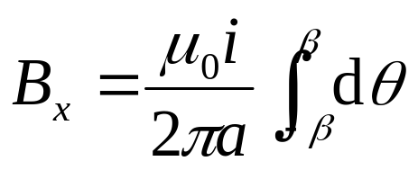
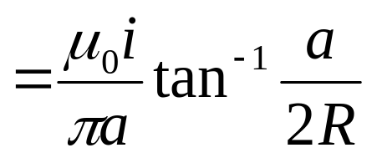
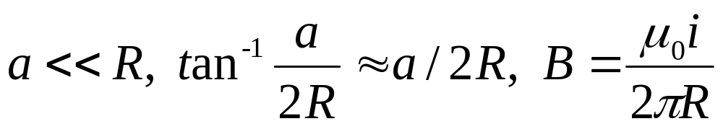
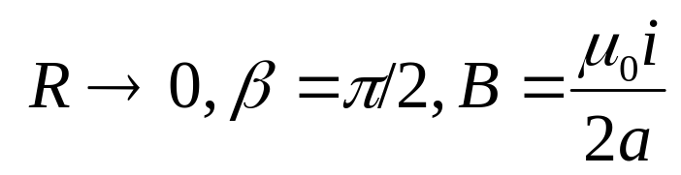
Example
β
−β

Slide 8
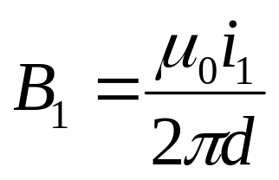
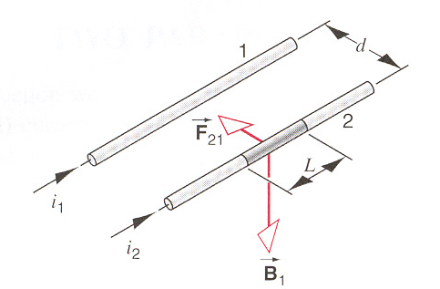
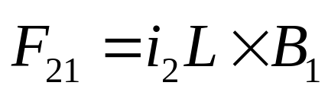
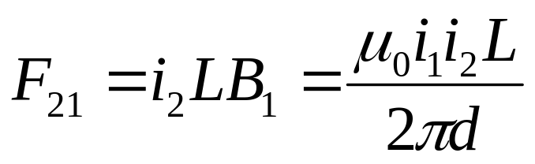
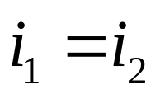
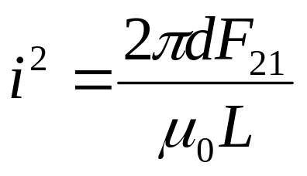

The force exerted by one wire on another
The definition of the ampere
•
•
i_{b}
d
i_{b}
d
Parallel currents attract, and antiparallel currents repel.
i_{a}
i_{a}

Slide 9











The Magnetic Field of a Current
A circular current loop
Biot-Savart law
magnetic dipole

Slide 10

The Magnetic Field of a Solenoid

Slide 11





The Magnetic Field of a Solenoid
The field outside the ideal solenoid is zero.
If L>>R,
B=μ₀ni.

Slide 12
The Magnetic Field of a Solenoid
The field outside the ideal solenoid is zero.
B
z
-L/2
L/2

Slide 13
parallel-plate capable for electric field
solenoid for magnetic field
E
B
E=σ/ε₀.
B=μ₀ni.

Slide 14





The Electric Field Due to a Charge
The Magnetic Field Due to a Moving Charge
Gauss’ Law
Ampere’s Law

Slide 15




Ampere’s Law

Slide 16






Slide 17










Ampere’s Law

Slide 18



A straight wire segment

Slide 19









Application of Ampere’s law
Long, straight wire (r<R)

Slide 20







A solenoid
B₂
loop2
B₁
From loop2, hB₁+ (-h)B₂=0
B₁= B₂

Slide 21



A toroid
Same as a solenoid

Slide 22







The field outside a solenoid

Slide 23














Frame of Reference

Slide 24






Frame of Reference

Slide 25





Frame of Reference
In different reference frame, the electric or magnetic field is different.
In different reference frame, the results come from the electric or magnetic field is same.

Slide 26


Transformation equations of E and B:

Slide 27
Exercises
P768-769 10, 13, 15
Problems
P772 8, 9

